Slide 1
EE 5830 Final Project
Classification of 5G-NR Signals

Slide 2
Problem statement
This project implements a deep learning approach to classify 5G New Radio (5G-NR) signals
based on their Signal-to-Noise Ratio (SNR) levels. The system processes raw In-phase
and Quadrature (I/Q) samples from RF signals and classifies them into different SNR
categories using a Convolutional Neural Network (CNN).

Slide 3
What is SNR
Expressed in decibels (dB)
A measure of clarity of the signal relative to the background noise
The higher the number the better the signal quality

Slide 4
Approach
Taking raw In-phase and Quadrature (I/Q) data and converted to its complex form
Process and resize data
Test three SNR levels
20dB, 10dB, 0dB (Clean to quiet range)
Use CNN to classify

Slide 5
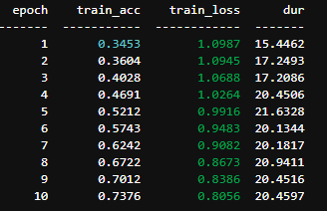
Results
Best results at 10 epoch with learning rate of 0.002
Added callbacks to track accuracy at each epoch

